Slide 1
Unit 2: Android Layouts
Sunil Gautam

Slide 2
Android UI Layouts
A layout defines the structure for a user interface in your app, such as in an activity. All elements in the layout are built using a hierarchy of View and ViewGroup objects. A View usually draws something the user can see and interact with. Whereas a ViewGroup is an invisible container that defines the layout structure for View and other ViewGroup objects.

Slide 3
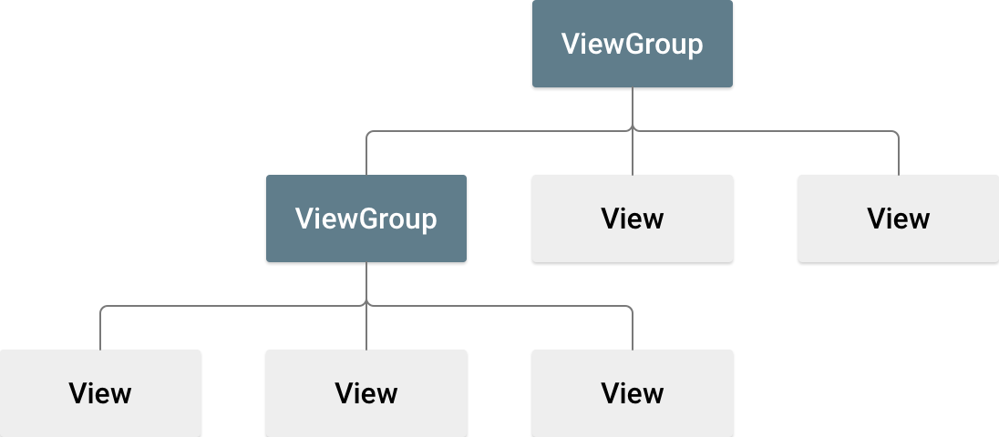
Android UI Layouts
The View objects are usually called "widgets" and can be one of many subclasses, such as Button or TextView. The ViewGroup objects are usually called "layouts" can be one of many types that provide a different layout structure, such as LinearLayout or ConstraintLayout.

Slide 4
Android UI Layouts
Declare UI elements in XML. Android provides a straightforward XML vocabulary that corresponds to the View classes and subclasses, such as those for widgets and layouts.
Instantiate layout elements at runtime. Your app can create View and ViewGroup objects (and manipulate their properties) programmatically.

Slide 5
Android UI Layouts
Linear Layout ( Horizontal)
Linear Layout ( Vertical)
Relative Layout
Table Layout
Constraint Layout
Frame Layout

Slide 6

Linear Layout
Android LinearLayout is a view group that aligns all children in a single direction, vertically or horizontally.
A layout that organizes its children into a single horizontal or vertical row. It creates a scrollbar if the length of the window exceeds the length of the screen.

Slide 7
Linear Layout
All children of a LinearLayout are stacked one after the other, so a vertical list will only have one child per row, no matter how wide they are, and a horizontal list will only be one row high (the height of the tallest child, plus padding).
A Linear Layout respects margins between children and the gravity (right, center, or left alignment) of each child.
android: orientation attribute needs to be modified.

Slide 8

Relative Layout
RelativeLayout is a view group that displays child views in relative positions.
The position of each view can be specified as relative to sibling elements (such as to the left-of or below another view) or in positions relative to the parent RelativeLayout area (such as aligned to the bottom, left or center).

Slide 9
Relative Layout Attributes
android:layout_alignParentTop :If "true", makes the top edge of this view match the top edge of the parent.
android:layout_centerVertical : If "true", centers this child vertically within its parent.
android:layout_below : Positions the top edge of this view below the view specified with a resource ID.
android:layout_toRightOf : Positions the left edge of this view to the right of the view specified with a resource ID.
RelativeLayout.LayoutParams | Android Developers

Slide 10
Table Layout
A layout that arranges its children into rows and columns.
A TableLayout consists of a number of TableRow objects, each defining a row
TableLayout containers do not display border lines for their rows, columns, or cells. Each row has zero or more cells; each cell can hold one View object.
The table has as many columns as the row with the most cells. A table can leave cells empty.

Slide 11
Table Layout Attributes
android:collapseColumns The zero-based index of the columns to collapse.
android:shrinkColumns The zero-based index of the columns to shrink.
android:stretchColumns The zero-based index of the columns to stretch.

Slide 12
Absolute Layout
A layout that lets you specify exact locations (x/y coordinates) of its children.
Absolute layouts are less flexible and harder to maintain than other types of layouts without absolute positioning.

Slide 13
Constraint Layout
ConstraintLayout allows you to create large and complex layouts with a flat view hierarchy
It's similar to RelativeLayout in that all views are laid out according to relationships between sibling views and the parent layout
To define a view's position in ConstraintLayout, one must add at least one horizontal and one vertical constraint for the view.
Each constraint represents a connection or alignment to another view, the parent layout, or an invisible guideline. Each constraint defines the view's position along either the vertical or horizontal axis; so each view must have a minimum of one constraint for each axis.

Slide 14
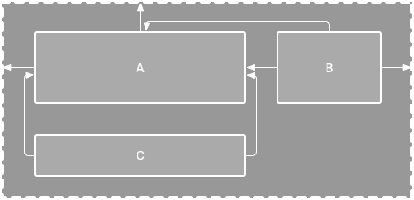
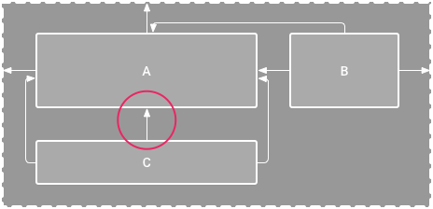
Constraint Layout
When you drop a view into the Layout Editor, it stays where you leave it even if it has no constraints.
However, if a view has no constraints when you run your layout on a device, it is drawn at position [0,0] (the top-left corner).
Figure 1. The editor shows view C below A, but it has no vertical constraint. Figure 2. View C is now vertically constrained below view A

Slide 15
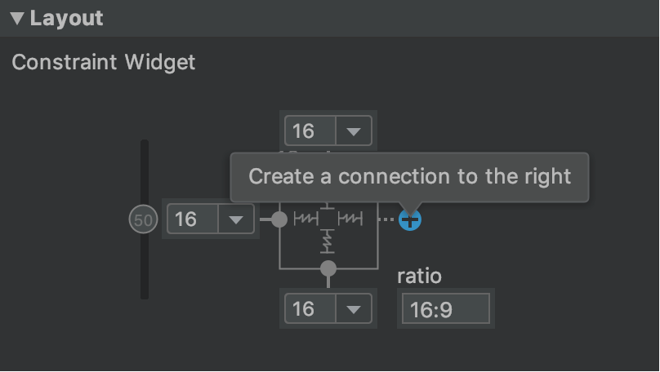
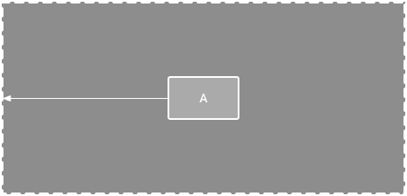
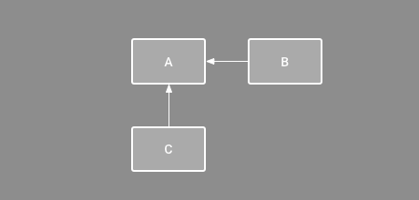
Constraint Layout
Setting the Constraints
Setting the Margins
Order Position : With Parent
Order Position : With other components

Slide 16
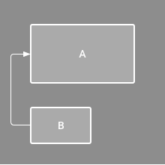
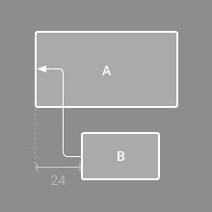
Constraint Layout
Alignment
Alignment with offset
Ex : Horizontal Alignment

Slide 17
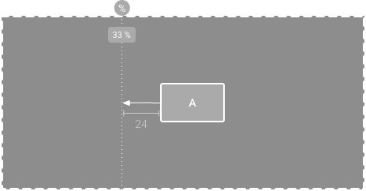
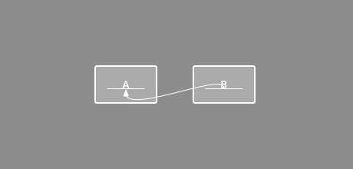
Constraint Layout
Constrain to Baseline (Use Show Baseline)
Constrain to Guideline (Create Guideline first)

Slide 18
Frame Layout
FrameLayout is designed to block out an area on the screen to display a single item.
Generally, FrameLayout should be used to hold a single child view, because it can be difficult to organize child views in a way that's scalable to different screen sizes without the children overlapping each other.
One can add multiple children to a FrameLayout and control their position within the FrameLayout by assigning gravity to each child, using the android:layout_gravity attribute.

Slide 19
Frame Layout
Android FrameLayout is one of the useful layouts provided by android system, which allows User Interface widgets to be overlapped with each other.
It’s used in cases such as placing a TextView over an ImageView.
This becomes quite difficult to implement using LinearLayout or RelativeLayout since they place widgets adjacent to each other.

